Slide 1
SAVEETHA SCHOOL OF ENGINEERING
SIMATS, CHENNAI - 602105
CSA0695 - DESIGN AND ANALYSIS OF ALGORITHM FOR OPEN ADDRESSING TECHNIQUES
Project Title: String Transformation
Project by
S.Sivanjali
192210508
Guided by
Dr.R Dhanalaksmi

Slide 2


String Transformation
Given two strings s and t of equal length n. Can perform the following operation on the string s: Remove a suffix of s of length l where 0 < l < n and append it at the start of s. For example, let s = 'abcd' then in one operation you can remove the suffix 'cd' and append it in front of s making s = 'cdab'. You are also given an integer k. Return the number of ways in which s can be transformed into t in exactly k operations.

Slide 3

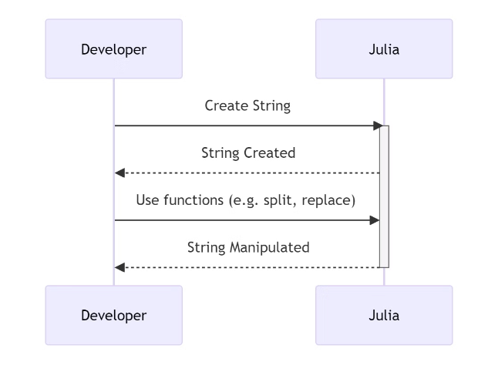
Abstract
String transformation refers to the process of changing or manipulating a string ( a sequence of characters) by applying various operations.
Remove a sufix of ‘s’ of length ‘l’ whee 0<l<n and append it at the start of ‘s’.
For s=’abcd’ we can remove ‘cd’ and append it to the beginnnng
resulting in cdab
Determine the number of ways to transform 's' into 't' using exactly 'k' operations.

Slide 4
Introduction
In this problem, we are given two strings s and t of equal length n, and an integer k. Our task is to determine the number of ways to transform string s into string t using exactly k cyclic shift operations.
A cyclic shift operation involves removing a suffix of string s of length l (where 0 < l < n) and appending it to the front of s. For instance, if s = "abcd", removing the suffix "cd" and appending it to the front results in the string "cdab".
The challenge lies in analyzing the rotations and determining if s can be transformed into t using exactly k shifts.

Slide 5
Complexity Analysis
The time complexity of this algorithm is O(n^2 * k), where 'n' is the length of the strings and 'k
' is the number of operations.
Time Complexity
Space Complexity
The algorithm iterates through all possible substrings of 's' and 't', resulting in a quadratic time complexity.
The algorithm uses a table of size O(n^2 * k) to store intermediate results.

Slide 6


Example
Now, let's consider another example with 's' = 'abca', 't' = 'acba', and 'k' = 2.
Operation
String 's'
String 't'
Initial
abca
acba
Operation 1
caab
acba
Operation 2
acba
acba

Slide 7


Implementation
The implementation of the algorithm will involve creating a function that takes the strings 's', 't', and the integer 'k' as input and returns the number of ways to transform 's' into 't' in exactly 'k' operations.
1
Dynamic Programming Table
2
Base Cases
Initialize the table with base cases where the substring lengths match and the number of operations is 0.
A 2D table will be used to store the number of ways to transform substrings of 's' into substrings of 't'.
3
Iteration
4
Result
Iterate through the table, calculating the number of ways for each substring combination.
Return the value at the position in the table corresponding to the full strings 's' and 't' and the specified number of operations 'k'.

Slide 8
code
#include <stdio.h>
#include <string.h>
#define MOD 1000000007
// Function to count transformations from s to t in exactly k operations
int count_transformations(char s[], char t[], int k) {
int n = strlen(s);
// Create a doubled string to check all cyclic permutations
char doubled_s[2 * n + 1];
strcpy(doubled_s, s);
strcat(doubled_s, s); // doubled_s = s + s
// Count the number of valid cyclic shifts
int count = 0;
for (int i = 0; i < n; i++) {
// Check if the substring of doubled_s starting at i matches t
if (strncmp(&doubled_s[i], t, n) == 0) {
// Check if this shift can be done in exactly k moves
if (k % n == i) {
count++;
}
}
}

Slide 9
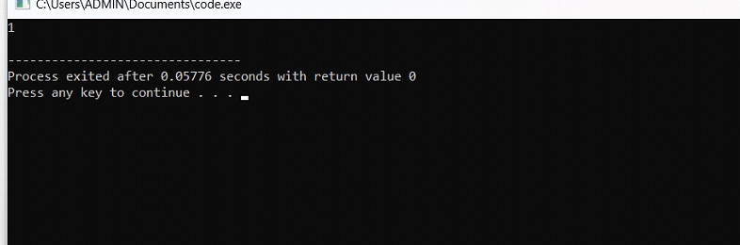
Output

Slide 10
Future scope
The problem of transforming one string into another through cyclic shifts has various applications and potential areas for future exploration and improvement.
Here are some areas where this problem could be expanded or refined. Extend the problem to consider not just cyclic shifts but a combination of different operations (e.g., cyclic shifts, reversals, rotations) and determine how these operations can be combined to achieve the transformation.
These future directions not only enhance the understanding and applicability of cyclic shifts and string transformations but also contribute to more efficient and practical solutions in various domains.

Slide 11


Conclusion
By utilizing a dynamic programming approach, we can efficiently calculate the number of ways to transform string 's' into string 't' using the specified operation. This solution demonstrates the power of dynamic programming in solving string manipulation problems.
This problem is a classic example of a coding challenge that requires algorithmic thinking and efficient implementation.
The use of dynamic programming provides a systematic and structured way to solve the problem, ensuring accuracy and efficiency.

